Slide 1
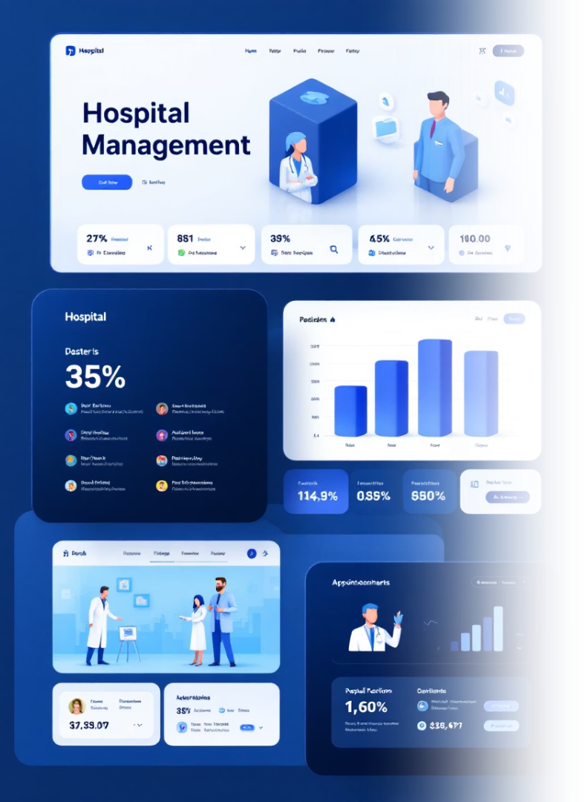
Hospital Management System – Backend

Slide 2





Team Members
Mohamed Atia
Mohamed El-Gazar
Mohamed Khaled
Mohamed El-Abady
Moamen El-Sha3rawy

Slide 3






Project Goal
Build a secure and scalable RESTful API to manage hospital operations such as patients, doctors, appointments, and medical records.
Secure
Protected patient data
Scalable
Handles growing hospital needs
Comprehensive
Complete hospital operations management

Slide 4

Technologies and System Architecture
Technology Stack
System Layers
ASP.NET Core (Backend Framework)
Controller: Handles HTTP requests
SQL Server (Database)
Service: Contains business logic
Entity Framework Core (ORM)
Repository: Handles database access
JWT (Authentication)
Postman and Swagger (Testing and Documentation)
Database: Stores persistent hospital data
GitHub (Version Control)

Slide 5
Database Schema
Main Entities
Patient
Doctor
Appointment
Name, Email, Password, Date of Birth, Contact, Address, Insurance, Emergency Contact
Name, Email, Password, Specialty, Hourly Pay, Experience, Contact
Date, Reason for Visit
Linked to: Patient ID, Doctor ID
Related to: Appointments, Medical Records, DoctorPatients
Related to: Appointments, DoctorPatients
Medical Record
DoctorPatient (Join Table)
Record Date, Diagnosis, Treatment, Notes
Doctor ID, Patient ID, Rating
Linked to: Patient ID
Relationships
One-to-Many: Patient to Appointments
One-to-Many: Doctor to Appointments
One-to-Many: Patient to Medical Records
Many-to-Many: Doctor and Patient (via DoctorPatient)

Slide 6

Key Features
JWT-based authentication
CRUD Operations
Secure authentication system for doctors and patients
Full Create, Read, Update, Delete operations for doctors and patients
Appointment Scheduling
Medical History
Appointment scheduling with validations
Patient medical history management
Data Integrity
Data integrity enforced through model validation

Slide 7
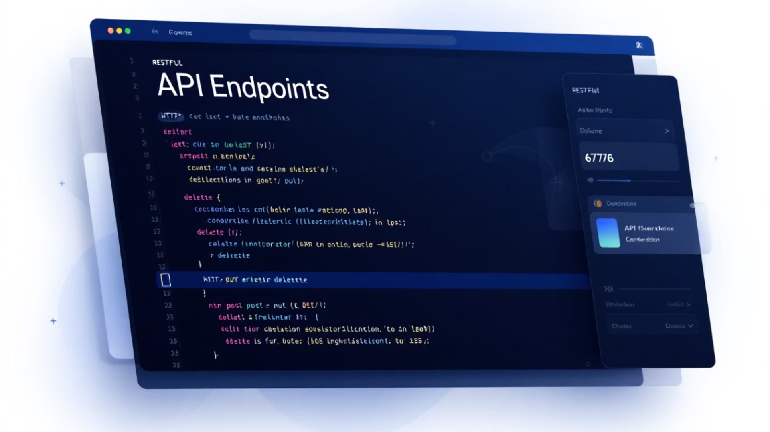
API Endpoints
Patients
Doctors
GET api/patients
GET api/doctors
POST api/patients
POST api/doctors
PUT api/patients/{id}
PUT api/doctors/{id}
DELETE api/patients/{id}
DELETE api/doctors/{id}
Appointments
Medical Records
GET api/appointments
GET api/medicalrecords
POST api/appointments
POST api/medicalrecords
PUT api/appointments/{id}
PUT api/medicalrecords/{id}
DELETE api/appointments/{id}
DELETE api/medicalrecords/{id}

Slide 8

Authentication Workflow
Authorization
Token Generation
Protected routes are enabled using authentication and authorization middleware
User Login
Generate JWT token after successful authentication
Validate user credentials (doctor or patient)
JWT token is passed in request headers for secure access

Slide 9








Testing and Validation
Testing Tools
Authentication Tests
Postman for request testing and Swagger for documentation
Authenticated versus unauthenticated access
Conflict Resolution
Validation Tests
Conflict resolution (e.g. overlapping appointments)
Missing or invalid fields
Building the backend that empowers tomorrow's healthcare.

Slide 10
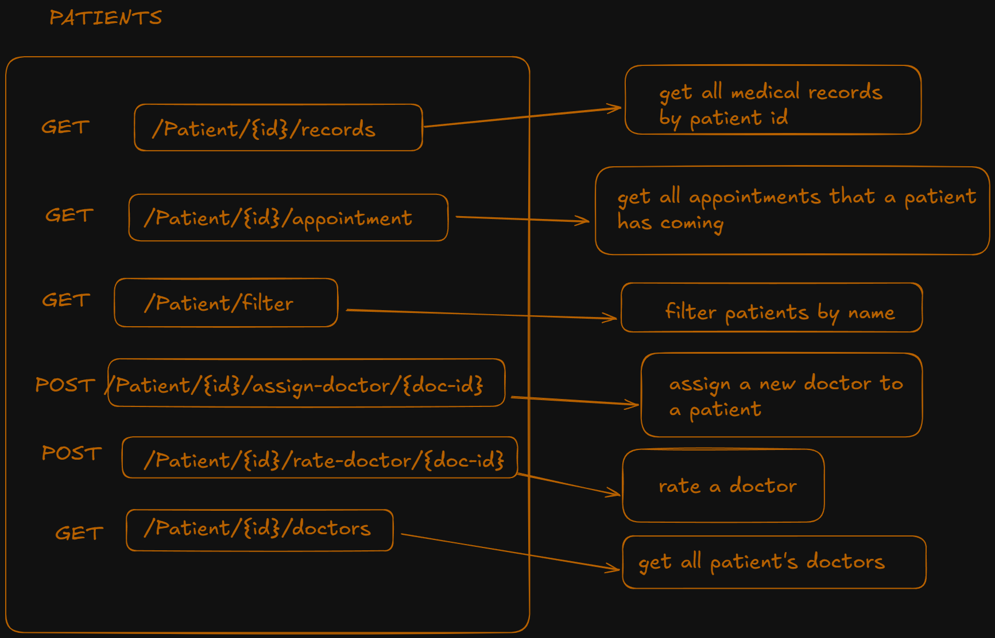

Slide 11
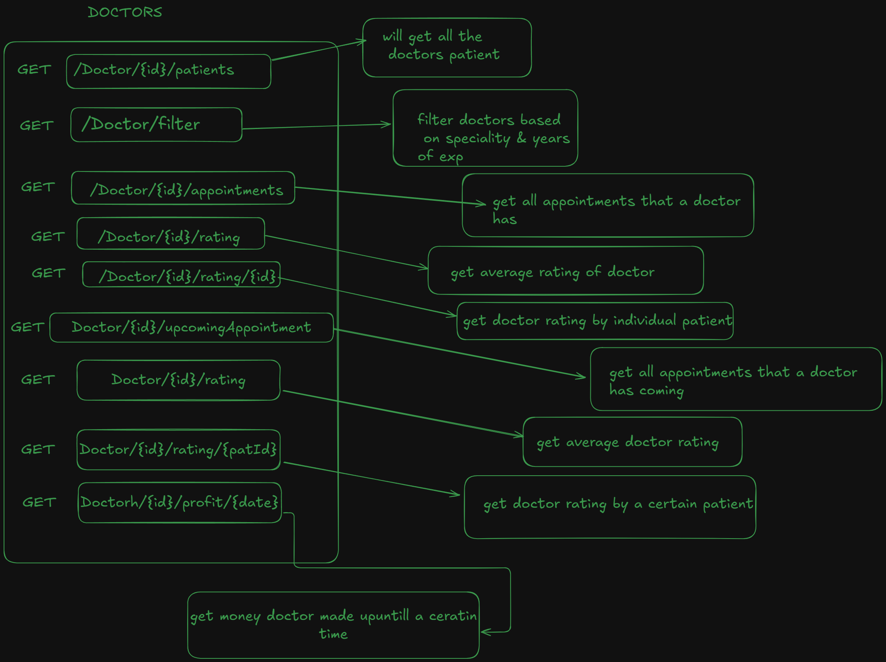

Slide 12
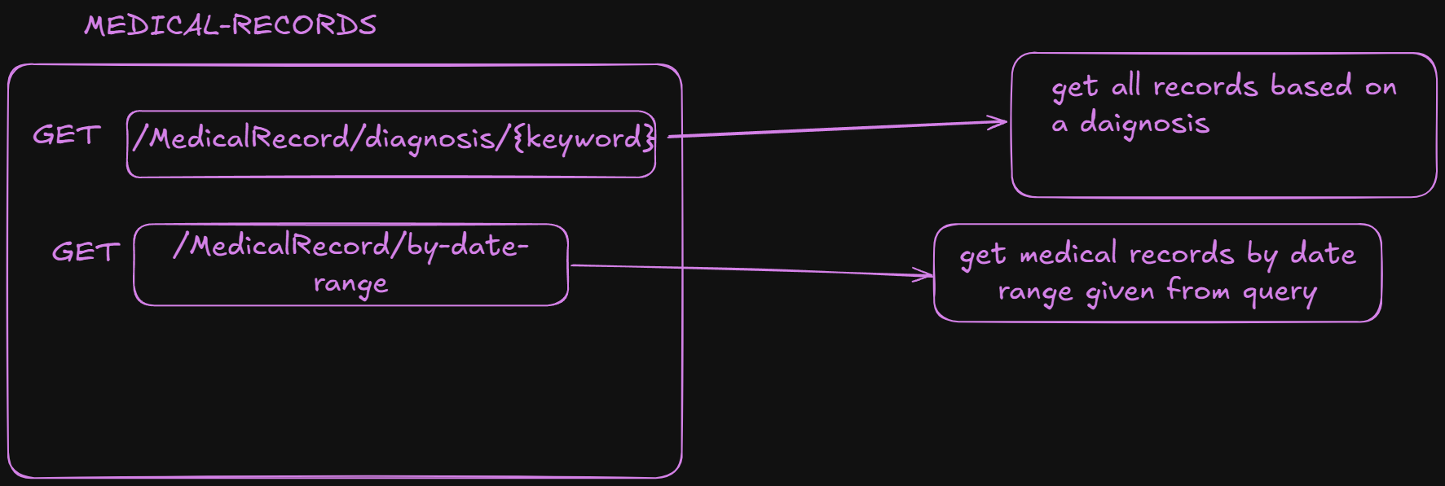

Slide 13
